Slide 1
Pakistani Pahiyah: Comprehensive Vehicle Database Management System
“Jaha Milay Sab Kuch, Jo Hum Ko Bhi Nahi Maloom"
Muhammad Sarmad Fowad (22i-2222)
Zain Khalid (22i-2161)
Summer 2024

Slide 2
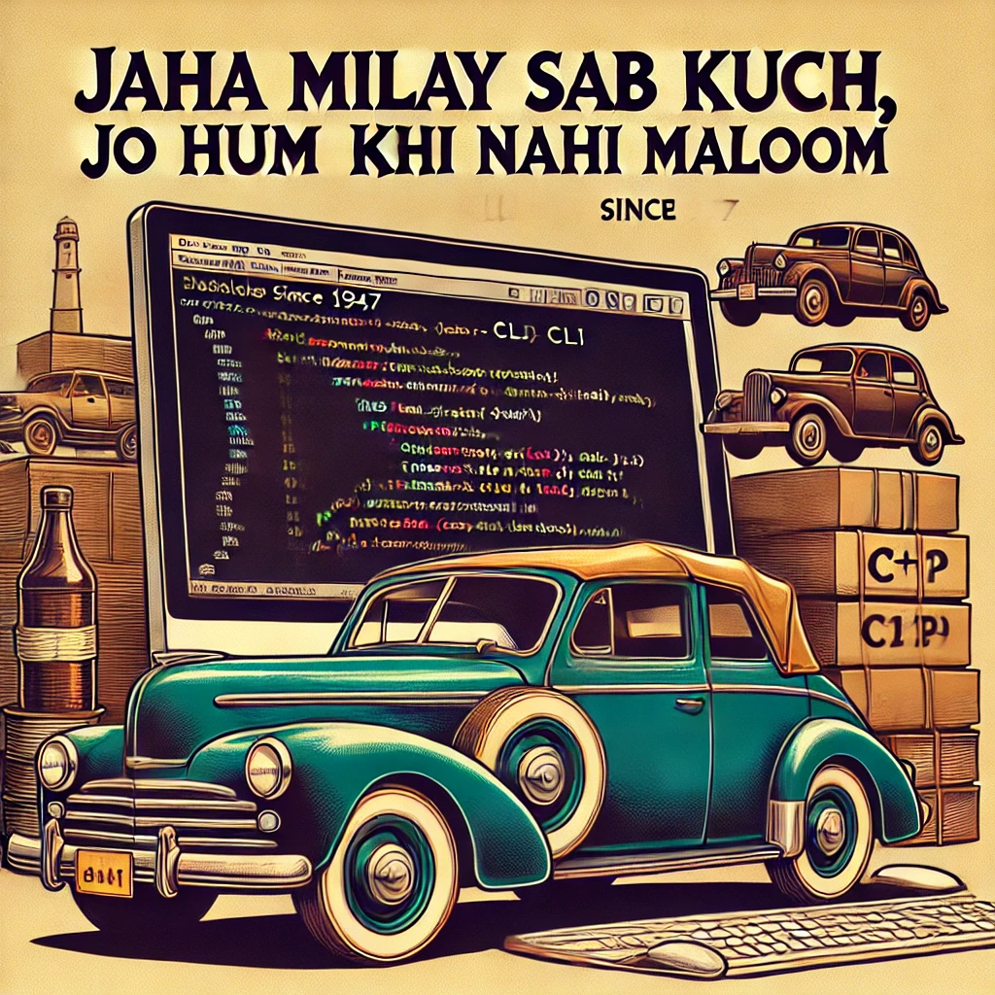
Overview
Objective:
- Develop a C++ CLI application managing a comprehensive database of vehicles in Pakistan since 1947.
- Provide detailed information on all car models, including rare and discontinued vehicles.
Tagline Explanation:
- 'Jaha Milay Sab Kuch, Jo Hum Ko Bhi Nahi Maloom' signifies the extensive coverage of all vehicle data.

Slide 3
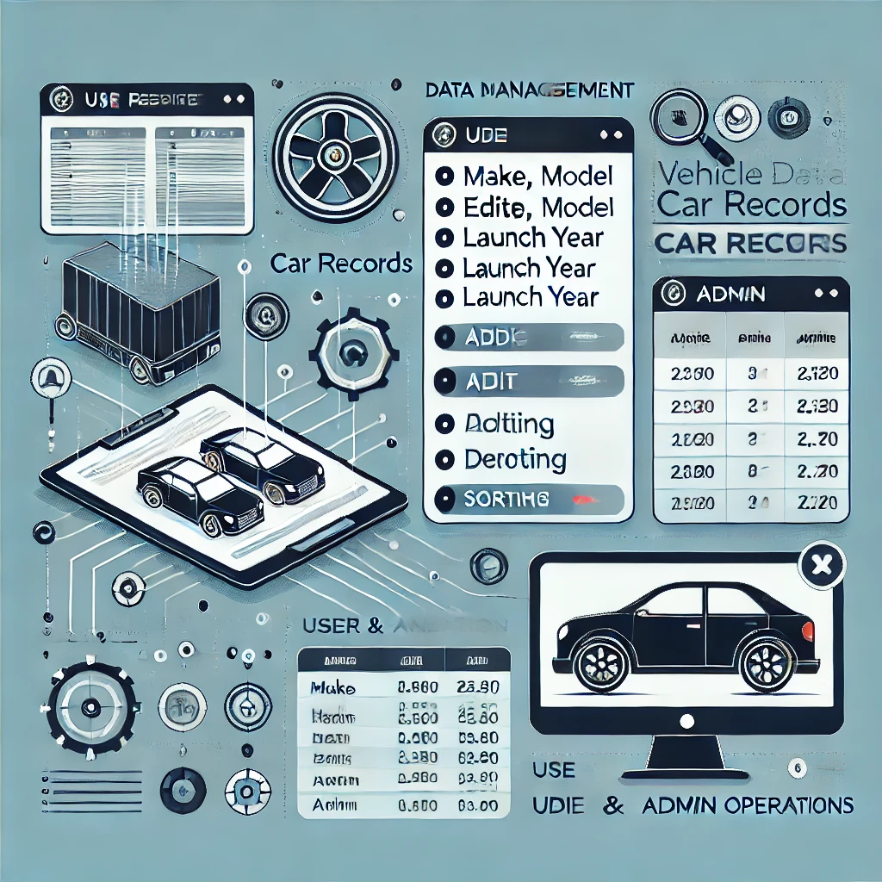
Objectives and Features
Comprehensive Vehicle Data:
- Maintain records of all cars from past to present.
- Include details like make, model, launch year, engine size, and more.
User Operations:
- Add, edit, and delete car record, etc….
- Sort and retrieve data based on various parameters.
- Manage user and admin operations.

Slide 4
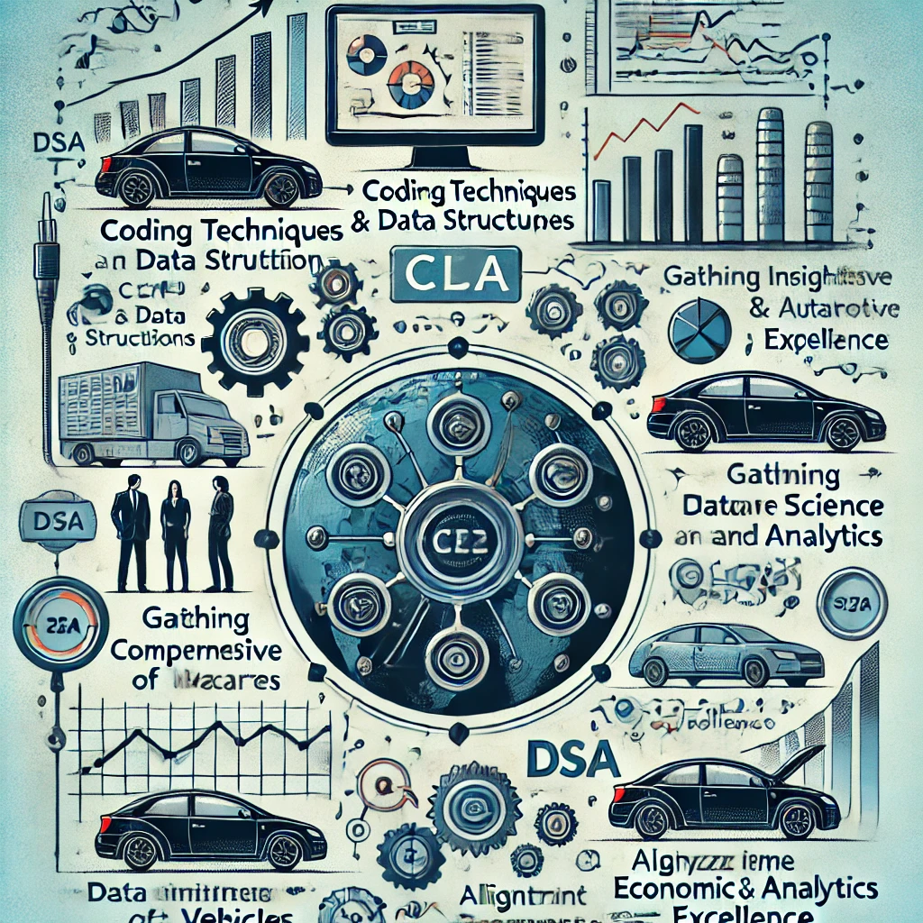
Project Rationale
Why This Project?
- Application of coding techniques and data structures.
- Gain insights into the automotive industry.
- Align with Data Science and Analytics (DSA) excellence.
Research and Market Exploration:
- Gather comprehensive data about cars.
- Analyze real-time economic trends in the automotive industry.

Slide 5
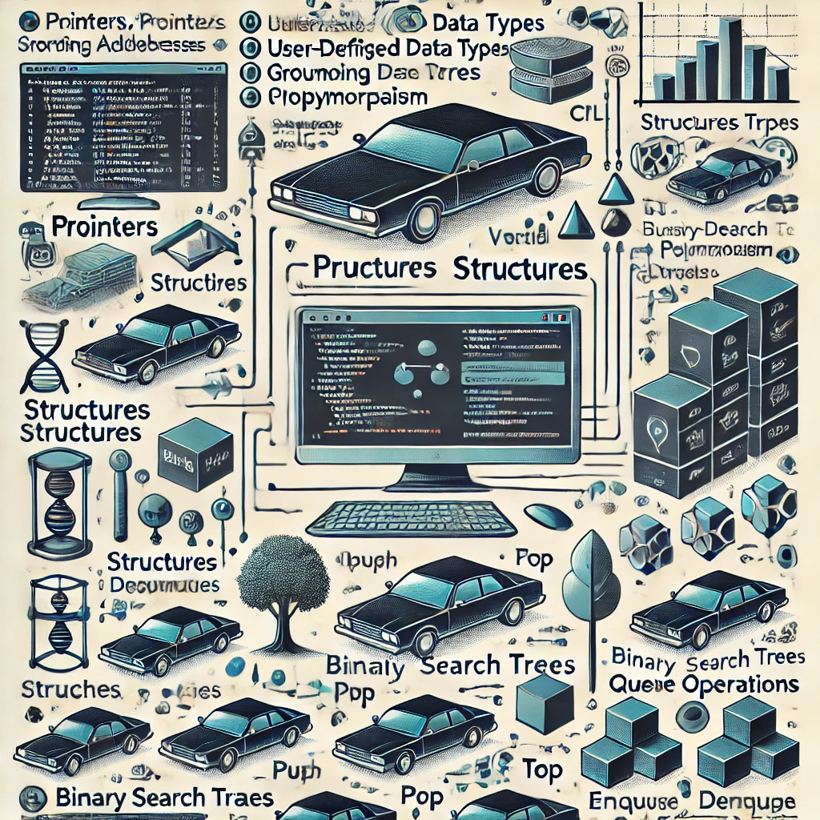
Algorithms and Data Structures
Algorithms and Techniques:
- Pointers: Variables storing memory addresses.
- Structures: User-defined data types grouping related data.
- Classes: Encapsulation, inheritance, polymorphism, etc.
- Trees: Hierarchical data storage (e.g., Binary Search Trees, AVL trees).
- Stack: Operations like push(), pop(), and top().

Slide 6
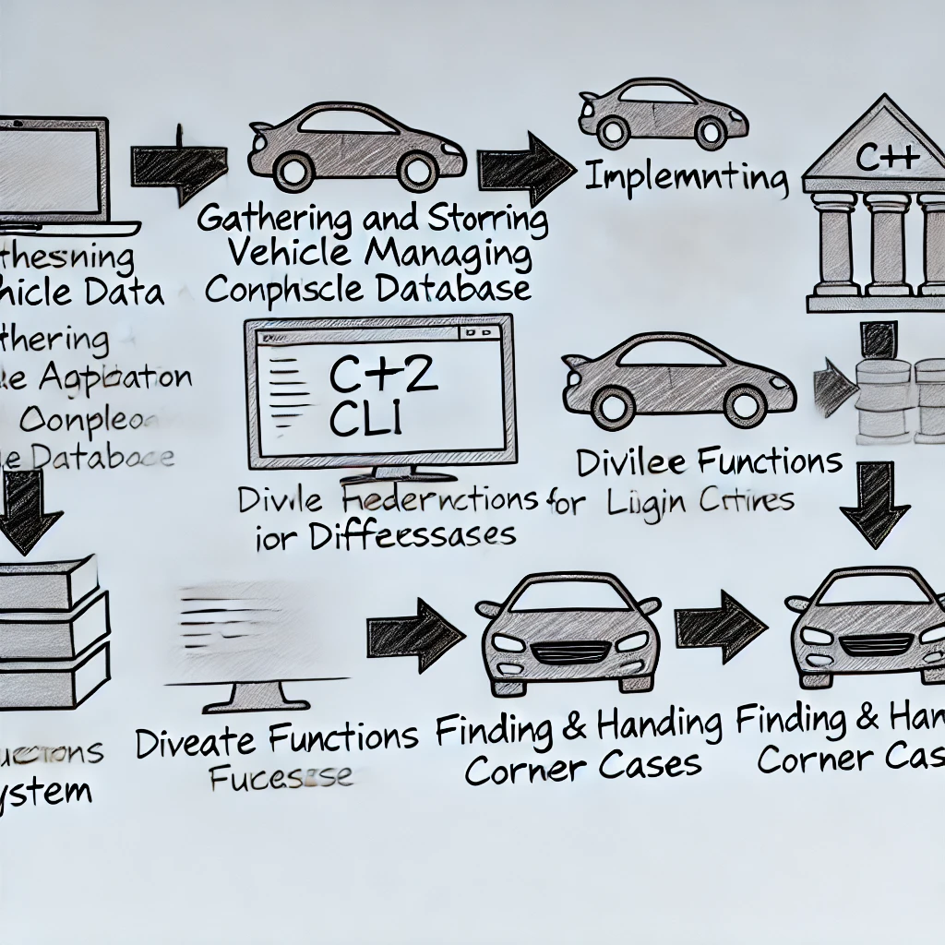
Execution Strategy
Development Steps:
- Gather and store vehicle data.
- Implement login system.
- Divide functions for different logins.
- Develop and test functions.
- Create header files if necessary.
- Find and handle corner cases.
- Perform robust testing.
Resource Utilization:
- Use previous assignments and online sources.

Slide 7
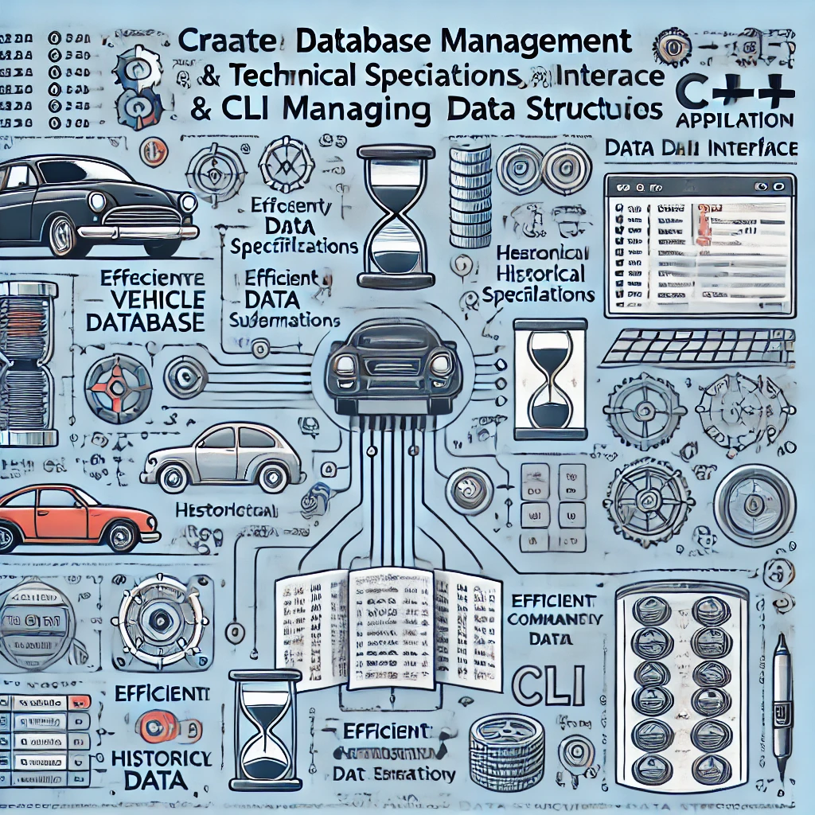
Technical Approach
Database Management:
- Store detailed car information, including technical specifications and historical data.
- Efficient data retrieval and manipulation using advanced data structures.
CLI Interface:
- Provide a user-friendly command-line interface for accessing and managing the database.

Slide 8
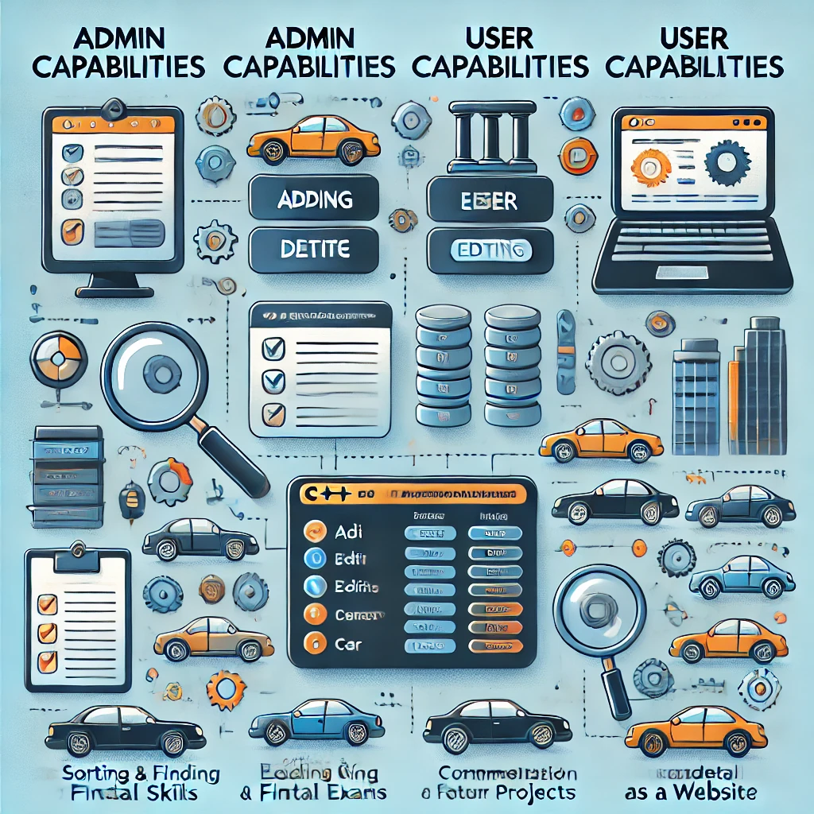
Expected Results and Benefits
Admin Capabilities:
- Add, delete, and edit car records.
- Implement user-related functions.
Etc …
User Capabilities:
- Sort and find car data based on specific criteria.
- Retrieve detailed car information.
Overall Benefits:
- Enhance practical development skills.
- Prepare for final exams and future projects.
- Potential for commercialization as a website.

Slide 9
Flow charts
Created online via using MIRO ONLINE TOOL.
Lets move toward them.

Slide 10
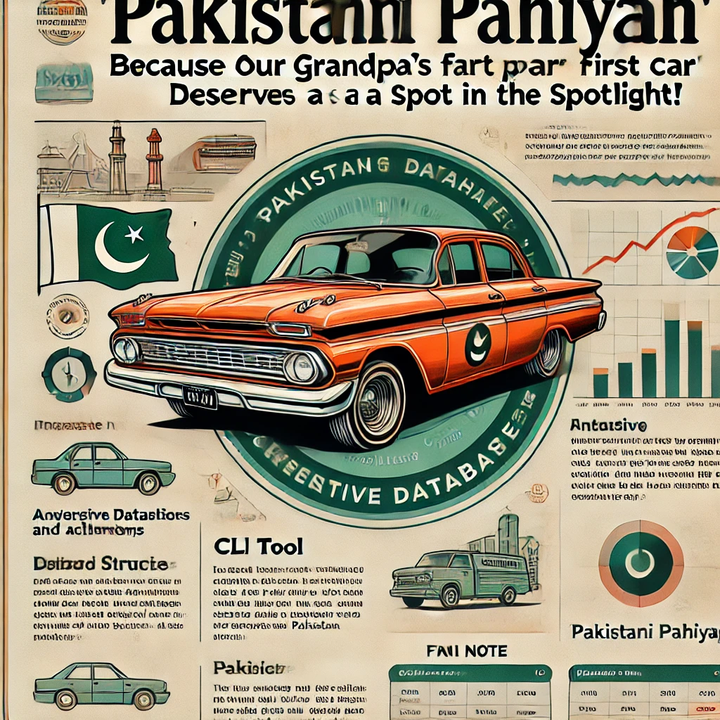
Conclusion
Summary:
- The 'Pakistani Pahiyah' project aims to create a comprehensive vehicle database for Pakistan.
- Utilizing advanced data structures and algorithms, this CLI tool provides exhaustive vehicle information.
- Serves as a valuable resource for enthusiasts and researchers.
- Holds potential for future expansion and commercialization.
Final Note:
- 'Pakistani Pahiyah: Because even our grandpa’s first car deserves a spot in the spotlight!'

Slide 11

Q&A
Questions and Discussion:
- Open floor for questions and feedback from the audience.
- Discuss potential improvements and additional features.

